Slide 1
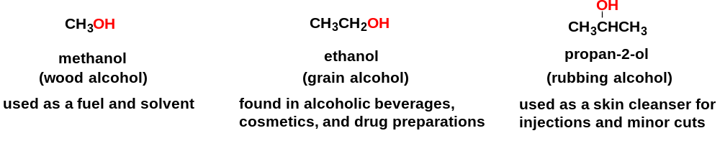
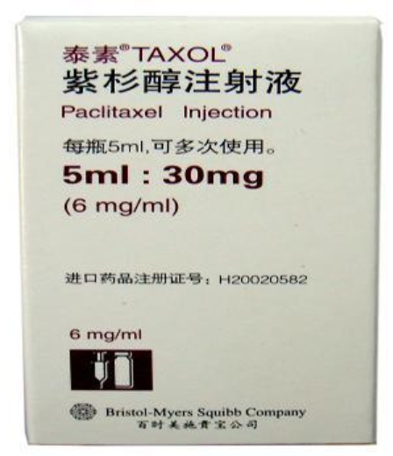
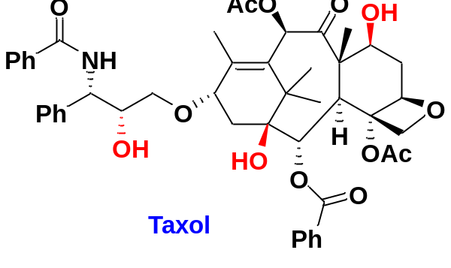
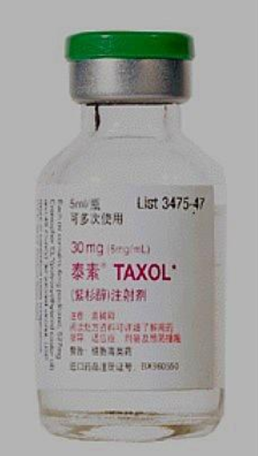
Chapter 8 Alcohols, Phenol, and Ethers
8-1 Alcohols--Introduction
Alcohols are organic compounds containing hydroxyl functional groups (−OH).
Alcohols are some of the most common and useful compounds in nature, in industry, and around the house.
Taxol is a cancer medication that interferes with the growth and spread of cancer cells in the body, used to treat breast cancer, ovarian cancer, and lung cancer

Slide 2
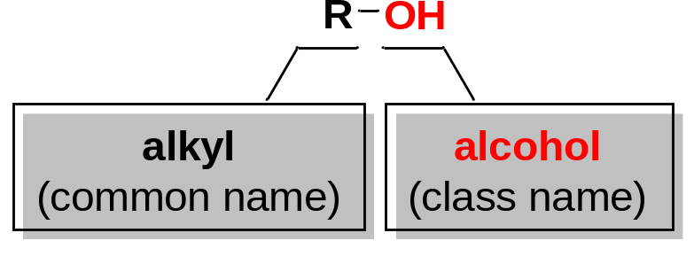
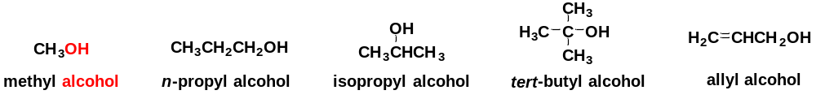
8-2 Nomenclature of Alcohols
8-2-1 Names of Alcohols
1. Common names
The common name of an alcohol is derived from the common name of the alkyl group and the word alcohol.
2. IUPAC names
In general, the IUPAC name carries the –ol suffix, together with a number to give the location of the hydroxyl group.
Linear saturated alcohols
Cyclic alcohols
Alcohols containing double and triple bonds
Alcohols with a higher-priority functional group

Slide 3
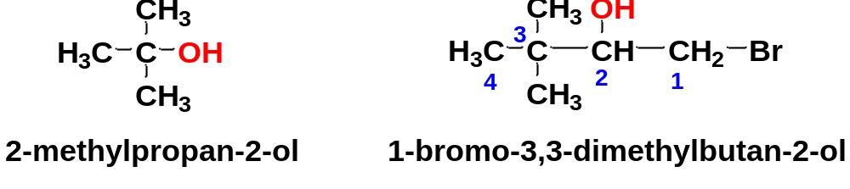
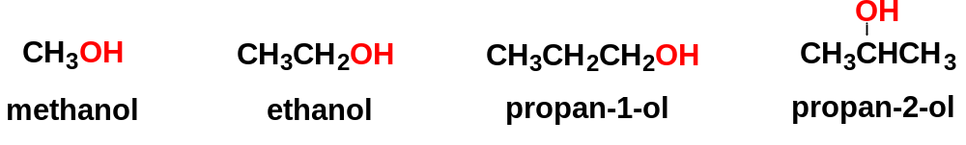
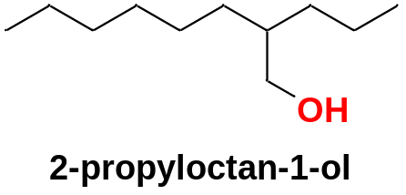
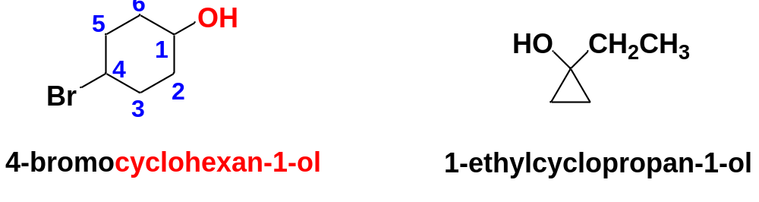
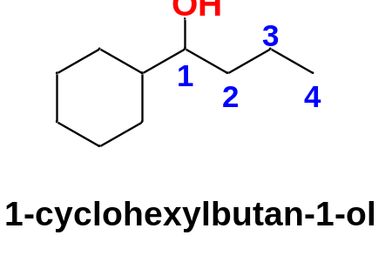
IUPAC nomenclature of linear saturated alcohols
Name the longest carbon chain that contains the carbon atom bearing the OH group.
Drop the final –e from the alkane name and add the suffix –ol to give the root name.
Number the longest carbon chain starting at the end nearest the OH group, and use the appropriate number to indicate the position of the OH group.
Name all the substituents and give their numbers.
IUPAC nomenclature of cyclic alcohols
(1) Cyclic alcohols are named using the prefix cyclo-.
(2) The OH is assumed to be on C1.
the OH is not bonded to the ring carbon: it’s not a cyclic alcohol

Slide 4
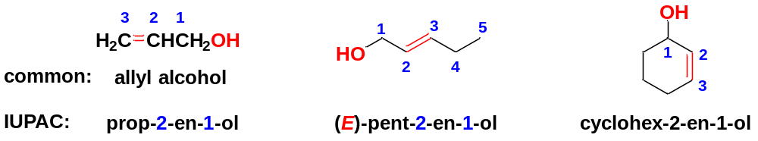
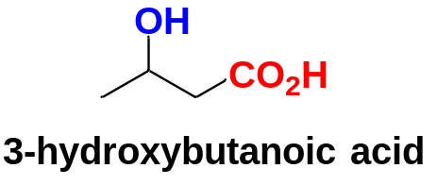
IUPAC nomenclature of unsaturated alcohols
In naming alcohols containing double and triple bonds, use the –ol suffix after the alkene or alkyne name.
(1) Choose the longest chain that contains the OH-bearing carbon as the main chain.
(2) The chain is numbered to give the lowest possible number to the carbon atom bonded to the OH.
(3) The position of the OH group is given by putting its number before the –ol suffix. The numbers for the multiple bonds are put before the –en or –yn suffix.
In case the OH group appears on a structure with a higher-priority functional group, it is named as a hydroxy substituent.
Priority of functional groups in naming organic compounds
−CO₂H > −CHO > −COR > −OH > −NH₂

Slide 5
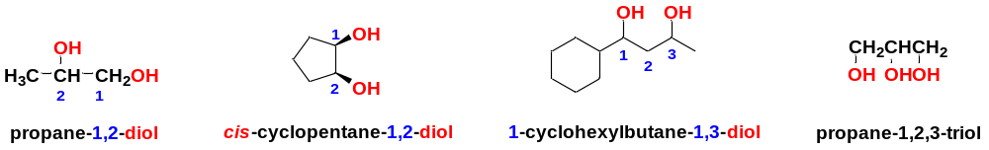
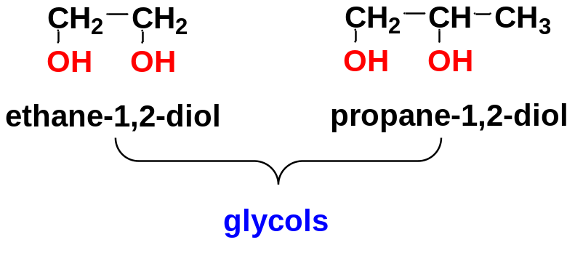
8-2-2 Names of Diols
Alcohols with two OH groups are called diols.
Diols are named like other alcohols, except that: (1) the suffix diol is used; (2) two numbers are needed to indicate the positions of the two OH groups.
The term glycol generally means a 1,2-diol.

Slide 6
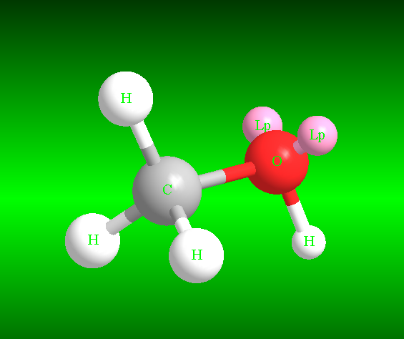
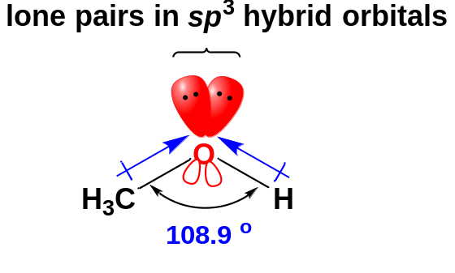
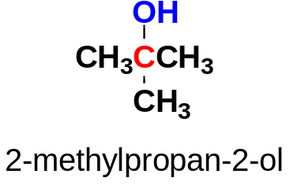
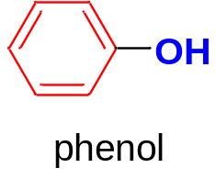
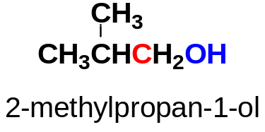
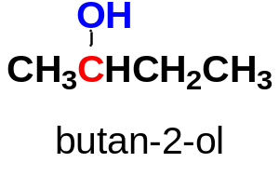
8-3 Structure and Classification of Alcohols
Alcohols have tetrahedral oxygen atoms in the −OH groups (sp³ hybridized oxygen atoms).
Each sp³ hybrid orbital has a lone pair.
Both the C−O bond and H−O bond are polar bonds.
Alcohols are highly polar molecules with the H-bonding ability.
sp³ hybridized oxygen
Alcohols are classified according to the type of carbinol carbon atom: (the C bonded to the OH group).
Type | Primary alcohol | Secondary alcohol | Tertiary alcohol | Phenol
Example

Slide 7
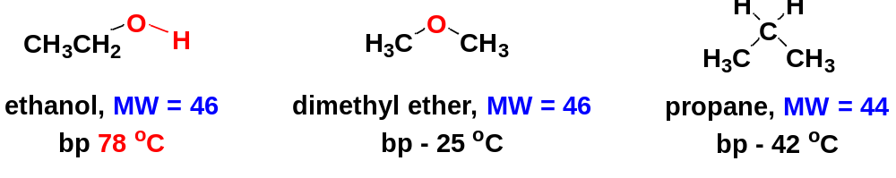
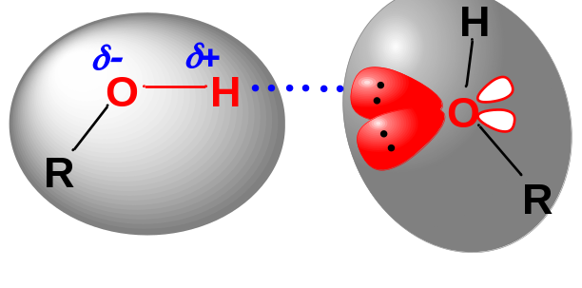
8-4 Physical Properties of Alcohols
8-4-1 High boiling points of alcohols
Such a large difference in boiling points suggests that ethanol molecules are attracted to each other much more strongly than propane molecules and dimethyl ether molecules.
The major intermolecular force responsible for this high boiling point is hydrogen bonding.
Hydrogen bonding

Slide 8
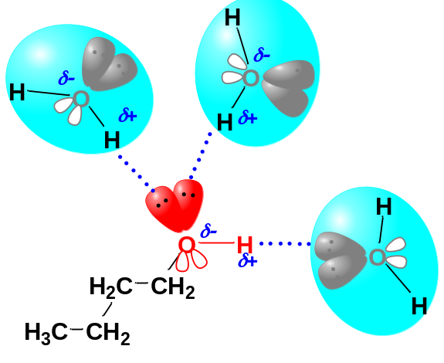
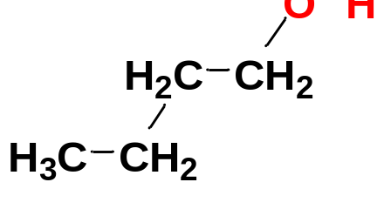
8-4-2 Hydrophilicity of alcohols
Alcohols form hydrogen bonds with water. Several of the lower-molecular-weight alcohols (methanol, ethanol, propan-1-ol etc.) are miscible with water.
We call the hydroxyl group hydrophilic, meaning “water loving”. The alkyl group in an alcohol makes it less hydrophilic, because alkyl group is hydrophobic, meaning “water hating”.
The water solubility of alcohols increases with increasing number of the −OH groups, decreases as the alkyl group becomes larger.
hydrophilic part
hydrophobic part

Slide 9
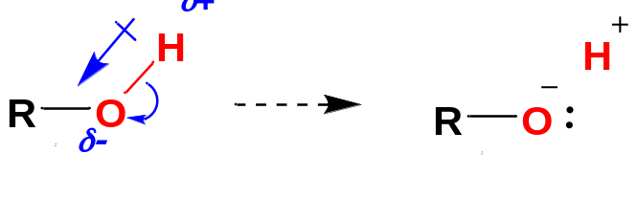
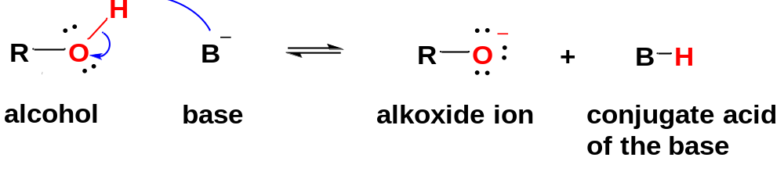


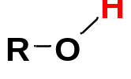

8-5 Acidity of Alcohols and Phenols
Like the hydroxyl proton of H₂O, the hydroxyl proton of an alcohol is acidic.
The acidities of alcohols are measured by the acid-dissociation constant K_{a}.
Normally, an alcohol is much more acidic than a terminal alkyne.
Compound | Conjugate base | pK_{a}
 |  | 25
 |  | 16-18

Slide 10
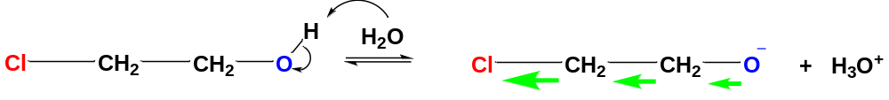
8-5-1 The effect of substituents on acidities of alcohols
Alcohol | pK_{a}
CH₃OH | 15.5
CH₃CH₂OH | 15.9
(CH₃)₂CHOH | 16.5
(CH₃)₃COH | 18.0
The acidities of alcohols vary widely, depending on their structures.
The acidity decreases as the alkyl group becomes more highly substituted.
By contrast, substitution by EWG enhances the acidity of alcohols.
Alcohol | pK_{a}
CH₃CH₂OH | 15.9
ClCH₂CH₂OH | 14.3
Cl₃CCH₂OH | 12.2
It is helpful to predict the strength of the acidity of an alcohol by considering the stability of corresponding conjugate base alkoxide.
More stable the alkoxide, more acidic the alcohol.
1. Inductive effect
2
1
2
1
The chlorine atom, as an EWG, helps to lower electron density of the oxygen atom of the alkoxide ion by electron-withdrawing inductive effect, thus stabilizing the alkoxide and increasing the tendency of ionization of the alcohol.

Slide 11
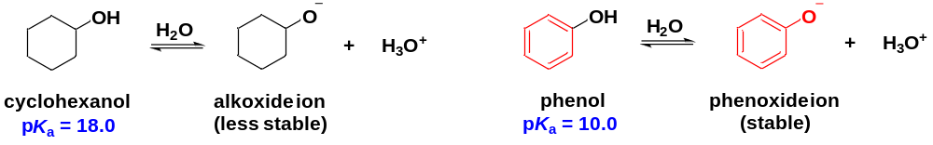
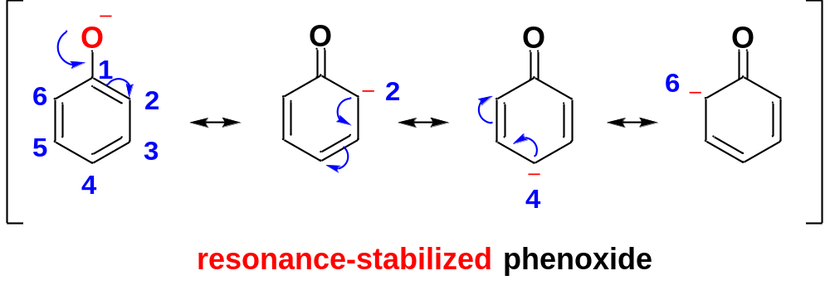
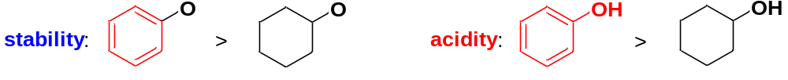
2. Resonance effect
Phenol is much more acidic than cyclohexanol due to a different effect: resonance effect.
The phenoxide ion is much more stable than a typical alkoxide ion because the negative charge is not confined to the oxygen atom but is delocalized over the oxygen and three carbon atoms of the ring by resonance.

Slide 12
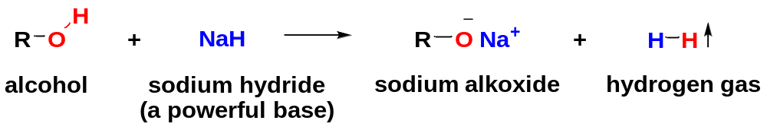
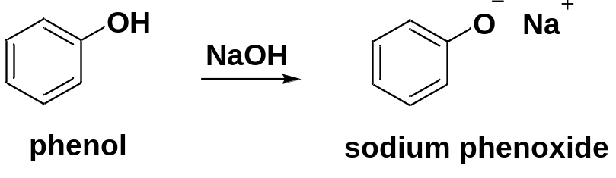
8-5-2 Formation of Sodium and Potassium Alkoxides
Sodium and potassium alkoxides can be formed by reaction of sodium hydride (NaH) with alcohols.
Phenoxides are prepared simple by adding the phenol to an aqueous solution of NaOH or KOH.
Alkoxide ions are useful reagents in organic synthesis (as Base or Oxygen Nucleophile) .

Slide 13
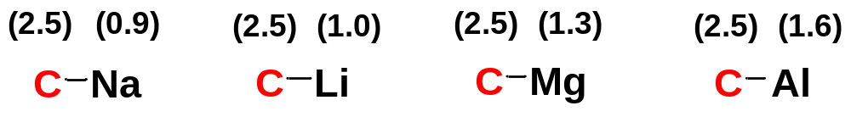
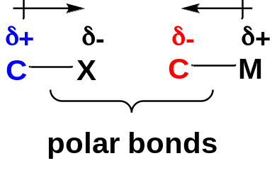
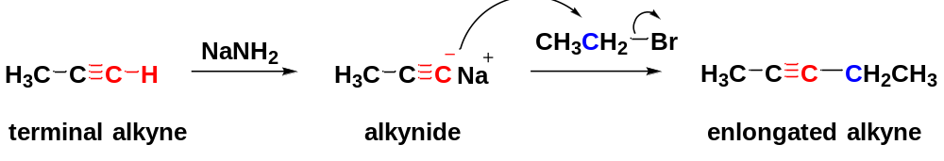
8-6 Organometallic Reagents for Alcohol Synthesis
Organometallic compounds contain bonds between carbon atoms and metal atoms.
The C−M bond is polarized with a partial positive charge on the metal and a partial negative charge on the carbon, because carbon is more electronegative than most metals.
Organometallic reagents R−M have nucleophilic carbon atoms, in contrast to the electrophilic carbon atoms of R−X.
Organometallic reagents provide some of our best ways of forming carbon-carbon bonds.

Slide 14
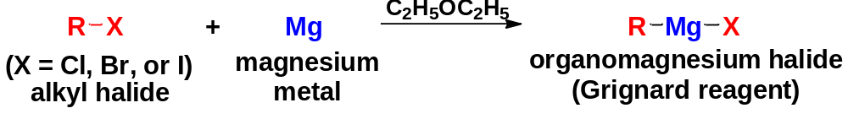
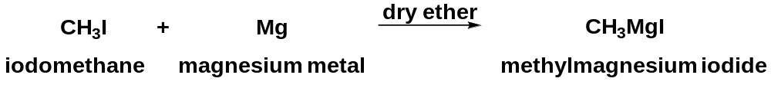
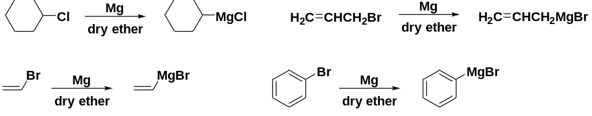
8-6-1 Grignard Reagents: Organomagnesium halides
The organomagnesium halides (R−Mg−X) are called Grignard reagents, in honor of the French chemist Victor Grignard.
Grignard reagents result from the reaction of an alkyl halide with magnesium metal in an ether solvent. This reaction is an example of inversion of polarity.
Grignard Reagents may be made from: methyl/1º/2º/3º alkyl halides, as well as from vinyl and aryl halides. RI are the most reactive halides, followed by RBr and RCl. RF generally do not react.
δ+
δ−

Slide 15
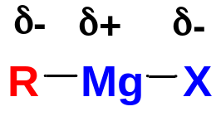
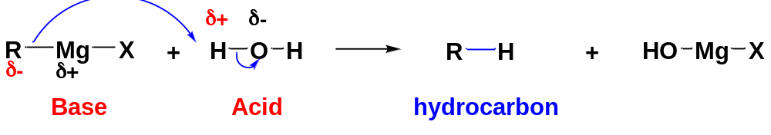
Grignard reagents are used as powerful carbon nucleophiles, resembling carbanions.
Though Grignard reagents are also strong bases, we do not tend to use them as bases.
Normally, we do not like this reaction! We try to avoid it because this reaction destroys the Grignard reagents.

Slide 16
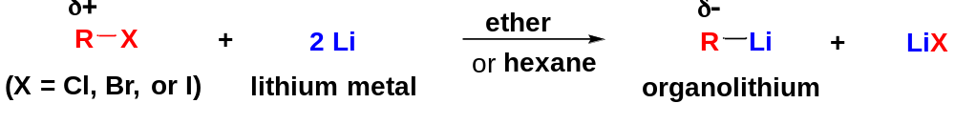
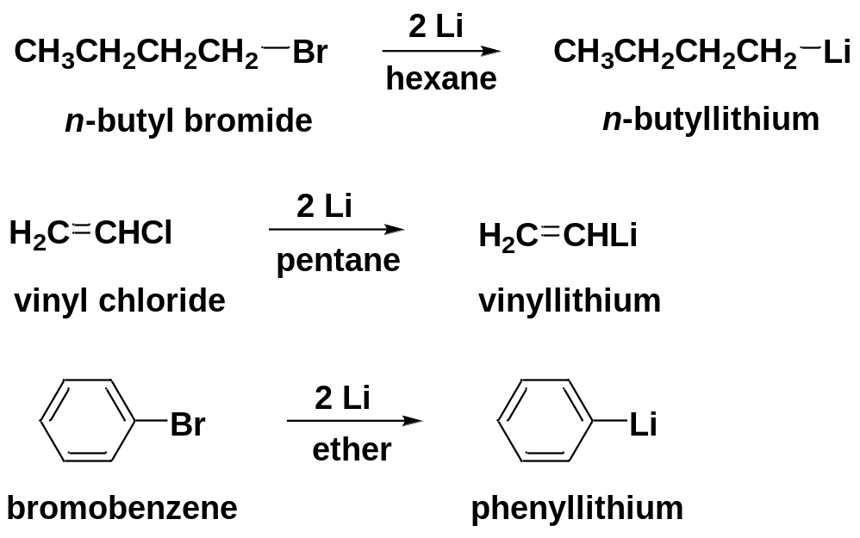
8-6-2 Organolithium Reagents
Like magnesium, lithium reacts with alkyl halides, vinyl halides, and aryl halides to form organolithium reagents.
Organolithium reagents are also powerful carbon nucleophiles.

Slide 17
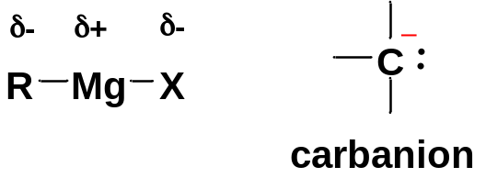
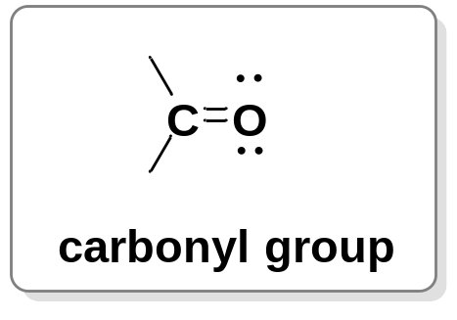
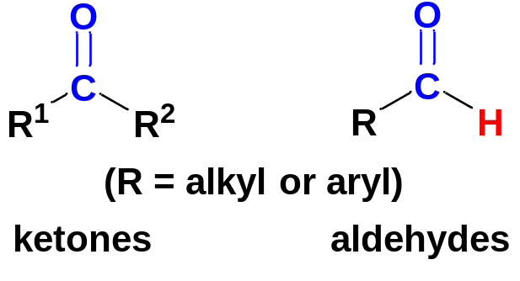
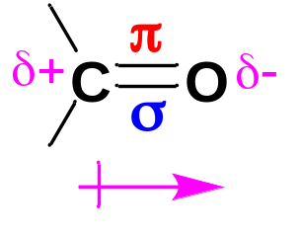
8-7 Synthesis of Alcohols by Nucleophilic Addition
Grignard reagents are strong nucleophiles resembling carbanions.
Grignard reagents undergo nucleophilic additions to aldehydes and ketones, as well as oxiranes, providing a versatile synthetic method for alcohols.
8-7-1 Nucleophilic Addition of Organometallic Reagents to Aldehydes and ketones
1. The structure of carbonyl group and aldehydes and ketones
The carbonyl group is a C=O double bond.
The C=O group consists of a σ bond (strong) and a π bond (relatively weak).
It is polarized, with the oxygen having a partial negative charge and the carbon atom having a partial positive charge (electrophilic carbon).
Electrophilic carbon

Slide 18
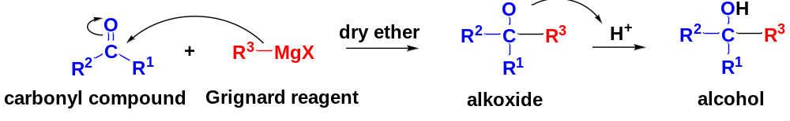
2. Nucleophilic Addition
Grignard reagents (and organolithium reagents) are strong nucleophiles, resembling carbanions.
Aldehydes and ketones have carbonyl groups with electrophilic carbonyl carbon atoms.
Nucleophilic Addition occurs between the carbonyl carbon C^{δ+} and the carbanion-like C^{δ-} of the Grignard Reagent.
Protonation after nucleophilic addition is complete
Nucleophilic Addition
^{δ-}
^{δ+}
This C-C sigma bond is formed
The nucleophilic additions of Grignard reagents to carbonyl compounds form alkoxides. In a separate step, the treatment of alkoxides with dilute acids protonates the alkoxides to give alcohols.
Grignard and organolithium reagents provide some of the best methods for synthesis of alcohols.

Slide 19
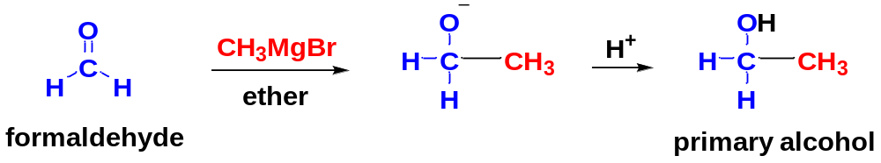


Grignard reactions can be used to form 1º/ 2º/ 3º alcohols.

Slide 20


3. Retrosynthetic Analysis and Synthetic Design
Reaction
Synthetic analysis
disconnect the C-C sigma bond between the O-bearing C and its adjacent C
disconnect the O-H bond to separate the target alcohol into 2 parts
step 2
step 1
step 3: find the reagents from the 3 parts

Slide 21


Retrosynthetic analysis of the target molecule (TM)
(TM)
Synthetic design

Slide 22




8-7-2 Nucleophilic Addition of Grignard Reagents to Epoxides (Oxiranes)
Epoxides (oxiranes) are unusually reactive ethers because of their ring strain.
The C-O bonds are polarized in epoxides, the C atoms being electrophilic.
Epoxides react with Grignard reagents to give primary alcohols with two additional carbon atoms.
Opening the three-membered ring relieves the ring strain.
Retrosynthetic analysis:

Slide 23



8-8 Synthesis of 1º and 2º Alcohols by Reduction of the Carbonyl Group
8-8-1 Uses of Complex Hydrides
Hydride reagents reduce the carbonyl group to an alkoxide ion, subsequent protonation gives the alcohol.
NaBH₄ (sodium borohydride) and LiAlH₄ (lithium aluminum hydride) are two most useful complex hydride reagents.
They Provide H⁻ (hydride ion) for the Nucleophilic Addition to Carbonyl group.
Step 2: Protonation
Two H atoms are added across the C=O, one from H⁻, the other from H⁺, in two separate steps
Step 1: Nucleophilic Addition
from H⁺
from H⁻

Slide 24


8-8-2 Catalytic Hydrogenation of Aldehydes and Ketones
Reducing an aldehyde or a ketone to an alcohol involves adding two hydrogen atoms across the C=O bond.
This addition can be accomplished by catalytic hydrogenation.
Raney nickel is an effective catalyst for hydrogenation of ketones and aldehydes to alcohols.
C=C is also reduced under this condition
C=C is not reduced by NaBH₄

Slide 25


Retrosynthetic analysis

Slide 26

8-9 Reactions of Alcohols
Alcohols are important organic compounds because the hydroxyl group is easily converted to almost any other functional group.
8-9-1 Oxidation States of Alcohols and Related Functional Groups
Alcohol oxidations are some of the most common organic reactions. Oxidation of alcohols leads to ketones, aldehydes, and carboxylic acids.
Organic chemists tend to consider oxidation as the result of adding an oxidizing agent (O₂, Br₂, etc.) and reduction as the result of adding a reducing agent (H₂, NaBH₄, etc).
Organic chemists habitually have simple rules for Oxidation-Reduction Reaction:
oxidation
oxidation
Oxidation:
addition of O/O₂; loss of H₂.
Reduction:
addition of H₂; loss of O/O₂.
loss of H₂
addition of O

Slide 27


8-9-2 Oxidation of Alcohols
Chromium reagents, permanganate, nitric acid and even household bleach (NaOCl, sodium hypochlorite) are commonly used oxidizing reagents.
Different types of alcohols undergo oxidation reaction differently.
1. Oxidation of 2º Alcohols
2º Alcohols are easily oxidized to give excellent yields of ketones.
Na₂Cr₂O₇ (sodium dichromate) / H₂SO₄ or CrO₃ (chromium trioxide) / dilute H₂SO₄ is often the chromic acid reagent of choice.

Slide 28




2. Oxidation of 1º Alcohols
Oxidation of a 1º alcohol initially forms an aldehyde. Unlike a ketone, however, the aldehyde is easily oxidized further to give a carboxylic acid.
Most oxidizing agents are strong enough to oxidize a 1° alcohol all the way to the carboxylic acid.
A good reagent for the limited oxidation of 1º alcohols to aldehydes is pyridinium chlorochromate (PCC).
PCC is a complex of chromium trioxide with pyridine and HCl, soluble in CH₂Cl₂.
PCC oxidizes most 1º alcohols to aldehydes in excellent yields

Slide 29

3. Resistance of 3º Alcohols to Oxidation
3° Alcohols do not have H atoms on the carbinol carbon atom, so they resist oxidation under normal conditions.
Under severe conditions, oxidation of 3° alcohols results in cleaving C-C bonds, giving mixtures of products. So oxidation of 3° alcohols is not an important reaction in organic chemistry.
4. The chromic acid test
The progress of a chromic acid oxidation can be observed from the color changes.
When a 1° or 2° alcohol is added to the chromic acid reagent, the orange color changes to green or blue.
When a 3° alcohol is added to the reagent, no immediate color change occurs.

Slide 30


8-9-3 Reactions of Alcohols with Hydrohalic Acids
HO⁻ is not a leaving group in S_{N}2 reactions, but H₂O is a good leaving group.
Acidic conditions protonate the OH group of an alcohol to make it easy to leave.
Once the alcohol is protonated, all the usual substitution reactions (and elimination reactions) are feasible, depending on the structure (1°, 2°, or 3°) of the alcohol.
HO⁻ is a poor LG
H₂O is a good LG

Slide 31


1. Reactions with HBr (hydrobromic acid)
Solutions of HBr and HCl contain both H⁺ and nucleophilic Br⁻ or Cl⁻ ions, which are commonly used to convert alcohols to the corresponding RBr or RCl.

Slide 32

1° Alcohols usually react with HBr by the S_{N}2 mechanism.
2° and 3° Alcohols usually react with HBr by the S_{N}1 mechanism.

Slide 33

2. Reactions with HCl (hydrochloric acid)
HCl reacts with alcohols in much the same way that HBr does.
Zinc chloride (a Lewis acid) is sometimes necessary to promote the reaction of HCl with 1º and 2º alcohols.
The reagent composed of HCl and ZnCl₂ is called the Lucas reagent.
1° alcohols react by S_{N}2 mechanism, slower than the S_{N}1 reaction of 2° and 3° alcohols.
The Lucas reagent reacts with 1º, 2º, and 3º alcohols at fairly predictable rates, which can be used to distinguish among the three types of alcohols.
Alcohol Type | Time to React/min
primary | > 6 slow
secondary | 1-5
tertiary | < 1 fast
The Lucas test involves adding the Lucas reagent to an unknown alcohol and watching for the second phase to separate.

Slide 34


3. Limitations on the use of hydrohalic acids with alcohols
Poor yields due to the side reactions such as elimination, rearrangements, etc.
Limited ability to make RI. Many alcohols do not react wit HI to give acceptable yields of RI.
rearrangement

Slide 35


8-9-4 Reactions of Alcohols with Phosphorus Halides
Several phosphorus halides are useful for converting alcohols to alkyl halides, including PBr₃, PCl₃, and PCl₅.
PI₃ is not sufficiently stable to be stored, but it can be generated in situ by the reaction of P with I₂.

Slide 36



Phosphorus halides produce good yields of most 1º and 2º alkyl halides, but none works well with 3º alcohols.
PBr₃ and P/I₂ are often the best reagents for converting 1º/2º alcohols to corresponding alkyl bromides and alkyl iodides.
Rearrangements are uncommon because no carbocation is involved in the reactions.

Slide 37


8-9-5 Reactions of Alcohols with Thionyl Chloride
SOCl₂ (thionyl chloride) is often the best reagent for converting an alcohol to an alkyl chloride.
It generally gives better yields than PCl₃ or PCl₅, especially with 3° alcohols.
The byproducts are gaseous SO₂ and HCl, which leave the reaction mixture and ensure there can be no reverse reaction.
gaseous byproducts

Slide 38


8-9-6 Dehydration Reactions of Alcohols
1. Formation of Alkenes by Intramolecular Dehydration
Alcohols undergo intramolecular dehydration under acidic conditions to produce alkenes, generally through the E1 mechanism.
To drive the reaction to the right, we often use a combination of distilling the products out of the reaction mixture and adding a dehydrating agent to remove water.

Slide 39


Intramolecular dehydration works best with 3° alcohols and almost as well with 2° alcohols.
Rearrangements and poor yields are common with 1° alcohols.
If two or more alkenes might be formed by deprotonation of the carbocation, the most highly substituted alkene (Zaitsev product) usually predominates.

Slide 40


2. Formation of Ethers by Intermolecular Dehydration
A protonated methanol or 1° alcohol may be attacked by another molecule of the same alcohol and undergo an S_{N}2 displacement.
The net reaction is an intermolecular dehydration to form an ether.
deprotonation
S_{N}2
protonation
Intermolecular dehydration can be used to synthesize symmetrical dialkyl ethers from simple, unhindered 1º alcohols or methanol.
Relatively high temperature favors elimination
Relatively low temperature favors substitution

Slide 41





8-9-7 Esterification of Alcohols
Alcohols react with carboxylic acids under acidic conditions to produce esters, accompanied by loss of H₂O.
We will discuss the mechanism of esterification in later chapter.
Alcohols can also react with inorganic acids under acidic conditions to produce corresponding esters.
a vasodilator drug used for the treatment of chest pain and high blood pressure
also used to make dynamite

Slide 42


8-10 Unique Reactions of 1,2-Diols
8-10-1 The Pinacol Rearrangement
A shortcut to predicting the pinacol rearrangement product:

Slide 43




Mechanism:
Step 3: Methyl migration forms a more stable resonance-stabilized carbocation (rearrangement).
Step 1: Protonation of a hydroxyl group.
Step 2: Loss of water gives a carbocation.
The positive charge is delocalized over a carbon and an oxygen: resonance-stabilized
Step 4: Deprotonation gives the product.

Slide 44




8-10-2 Periodic Acid Cleavage of Glycols
1,2-diols are cleaved by HIO₄ to produce ketones and aldehydes
Hydroxylation of an alkene followed by periodic acid cleavage serves as a useful alternative to ozonolysis.

Slide 45



8-11 Special Reactions of Phenols
Much of the chemistry of phenols is like that of aliphatic alcohols.
However, phenols also undergo reactions that are not possible with aliphatic alcohols.
8-11-1 Oxidation of Phenols to Quinones
Chromic acid oxidation of phenol gives a conjugated 1,4-diketone called a quinone.
Benzene-1,4-diol is easily oxidized with very weak oxidants like AgBr.
In the presence of air, many phenols slowly autoxidize to dark mixtures containing quinones.

Slide 46



8-11-2 Electrophilic Aromatic Substitution of Phenols
Phenols are highly reactive substrates for EAS because hydroxyl group is strongly activating and ortho, para-directing.
Phenols are excellent substrates for halogenation, nitration, sulfonation, an some F-C reactions.
8-11-3 Electrophilic Aromatic Substitution of Phenoxide ions
Phenoxide ions are even more reactive than phenols toward electrophilic aromatic substitution.
They undergo electrophilic aromatic substitution with CO₂, a weak electrophile.

Slide 47


8-12 Ethers, and Epoxides
8-12-1 Introduction
Ethers are compounds of the formula R−O−R’ (R = alkyl or aryl groups).
Alcohols have hydroxyl groups as their functional groups, while ethers have alkoxyl groups as their functional groups.
Ethers generally are relatively unreactive. Because they are stable with many types of reagents, ethers are commonly used as solvents for organic reactions.

Slide 48




8-12-2 Nomenclature of Ethers
1. Common Names (Alkyl Alkyl Ether Names)
Common names of ethers are formed by naming the two alkyl groups on oxygen and adding the word ether. The alkyl groups are put in alphabetical order.
Common names are used for simple ethers.
2. IUPAC Names (Alkoxy Alkane Names)
IUPAC Names use the more complex alkyl group as the root name, and the rest of the ether as an alkoxy group.

Slide 49



3. Nomenclature of Cyclic Ethers
(1). Epoxides (Oxiranes)
Epoxides are three-membered cyclic ethers, usually formed by peroxyacid oxidation of the alkenes.
Common names: adding “oxide” to the name of the alkene that is oxidized.
IUPAC names: name epoxides as derivatives of the parent compound “oxirane”. The ring atoms are numbered starting with the oxygen atom and going in the direction to give the lowest substituent numbers.

Slide 50

(2) Tetrahydrofuran, Tetrahydropyran and Dioxane
THF and 1,4-dioxane are excellent organic solvents.

Slide 51




8-12-3 Structure and Polarity of Ethers
Ethers have a bent structure, with an sp³ hybrid oxygen atom giving a nearly tetrahedral bond angle.
Ethers are strongly polar compounds.
Two polar C−O bonds
Two long pairs
Tetrahedral shape
8-12-4 Physical Properties of Ethers
Ethers are strongly polar molecules, but they lack the hydroxyl group of alcohols.
Boiling points lower than alcohols with similar molecular weights.
Water solubility lower than alcohols.
Densities: from 0.66-1.07 g/mL.
Ethers are ideal solvents for many organic reactions because they dissolve a wide range of polar and nonpolar substances, and their relatively low boiling points simplify their evaporation from the reaction products.

Slide 52





8-12-5 Synthesis of Ethers
(1) The Williamson Ether Synthesis
The Williamson ether synthesis is the most reliable and versatile ether synthesis.
This method involves the S_{N}2 attack of an alkoxide ion on methyl halide or an unhindered 1º alkyl halide (or tosylate).
2° Alkyl halides and tosylates are occasionally used, but elimination competes, and the yields are often poor.
Tosylate is a good leaving group

Slide 53



The Williamson ether syntheses fail with most 2º and all 3º alkyl halides (or tosylates) due to Elimination.
Retrosynthetic analysis and synthetic design:
1° alkyl group
3° alkyl group

Slide 54


(2) Industrial Synthesis: Intermolecular Dehydration of Alcohols
It is the least expensive method for synthesizing simple symmetrical ethers.
Unhindered 1° alcohols and low temperature must be used to produce ethers (S_{N}2 mechanism).
Branched, secondary/tertiary alcohols and temperature too high give alkene products (intramolecular dehydration, E1 mechanism).

Slide 55

8-12-6 Cleavage of Ethers by HBr and HI
Ethers are quite unreactive compared with alcohols.
However, ethers do undergo a limited number of characteristic reactions.
Ethers are unreactive toward most bases, but they can react under acidic conditions.
protonation
protonation increases the polarity of the C−O bonds and turns R’O⁻ into a better LG R’OH

Slide 56





Ethers are cleaved by heating with HBr or HI to give alkyl bromides or alkyl iodides, together with alcohols. In most cases, the alcohols react further to give alkyl bromides or alkyl iodides.
phenyl ethers with a benzene ring bonded to oxygen react with HBr or HI to give alkyl halides and phenols.
only the bond between O and the alkyl C breaks
the bond between O and the benzene carbon is strong enough to remain

Slide 57


8-12-7 Autoxidation of Ethers
When ethers are exposed to atmospheric oxygen, they slowly oxidize to produce hydroperoxides and dialkyl peroxides.
Such a spontaneous oxidation by atmospheric oxygen is called an autoxidation.
Hydroperoxides and dialkyl peroxides are potentially explosive.
Ethers should be brought in small quantities, kept in tightly sealed containers, and used promptly.
Any procedure requiring evaporation or distillation should use peroxide-free ether. Otherwise, these operations concentrate the peroxides and an explosion may occur.
Any ether that might be contaminated with peroxides should be discarded or treated to destroy the peroxides.

Slide 58


8-12-8 Epoxides (Oxiranes)
Epoxides are oxygen-containing three-membered rings.
Epoxides have great ring strain. The polar C-O bonds are prone to nucleophiles and break. The cleavage of the C-O bond opens the ring and releases the ring strain.
Epoxides are reactive electrophiles and valuable synthetic intermediates.
1. Synthesis of Epoxides
Peroxyacid epoxidation
Base-promoted cyclization of halohydrins
It is a variation of the Williamson ether synthesis, where an alkoxide ion and a halogen atom are located in the same molecule. The alkoxide displaces a halide ion and form a ring.

Slide 59


2. Ring Opening of Epoxides
Epoxides are much more reactive than common dialkyl ethers due to the large strain associated with the three-membered ring.
Ring Opening of epoxides takes place under nucleophilic (basic) conditions (and also acidic conditions).
(1) The use of hydroxide as a nucleophile
Backside attack by the Nu results in anti stereochemistry

Slide 60



(2) The use of alkoxide ions as a nucleophile
backside attack the less hindered C atom in an S_{N}2 displacement
(3) The use of Grignard reagents as a nucleophile

